Slide 1
Dean Bhavsar
Integrity
Do the right thing
Relationships
Confidence
Pride
Positivity
Humor
Grit

Slide 2
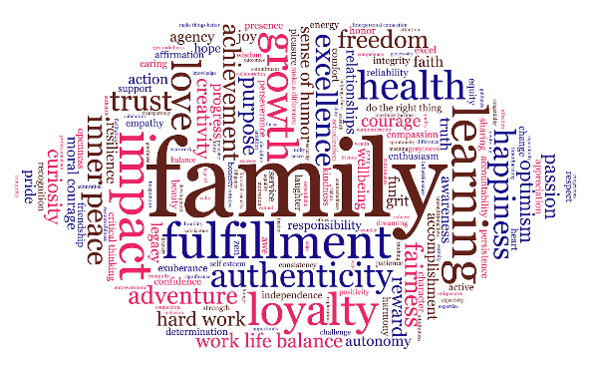

Slide 3
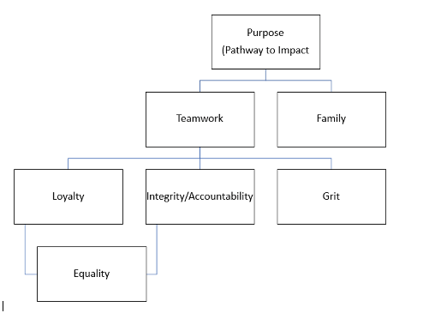
Mark Buonforte

Slide 5
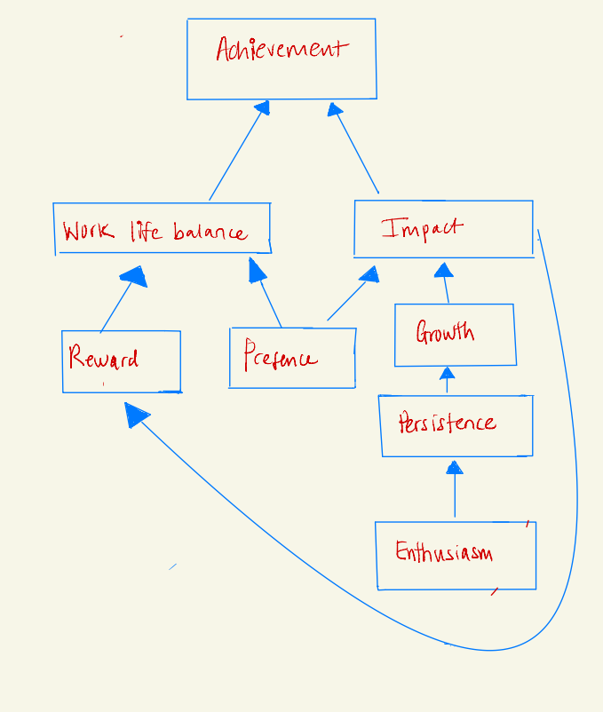
Riana Burlile

Slide 7
Matt Caliskan

Slide 9
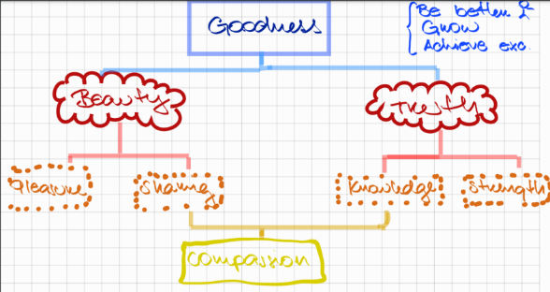
Luz Maria Carrion

Slide 11
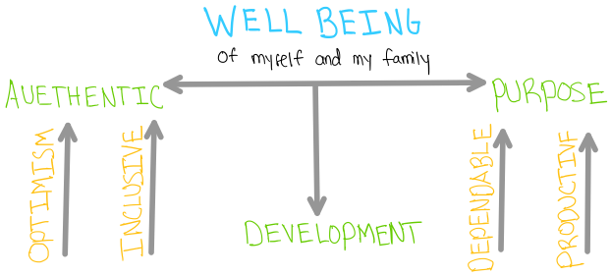
Brad Collins

Slide 13
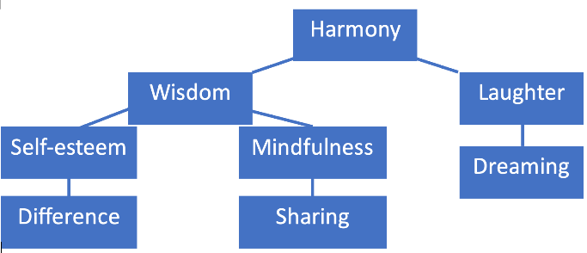
Xiuying Fan

Slide 15
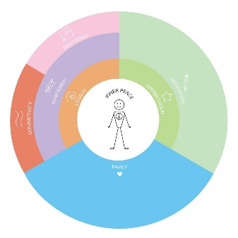
Matteo Focchi

Slide 17
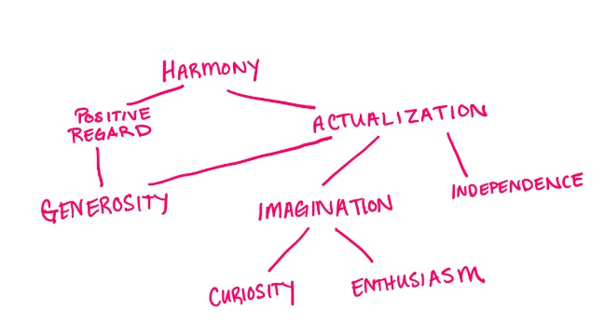
Victoria Fox

Slide 19
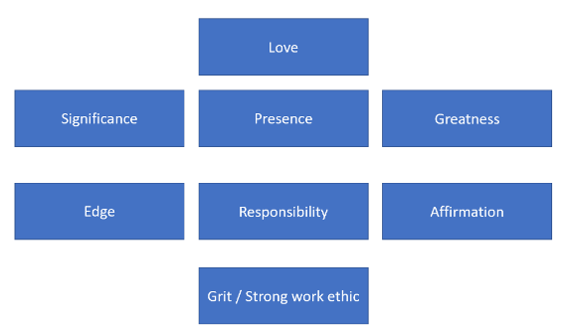
Austin Gast

Slide 21
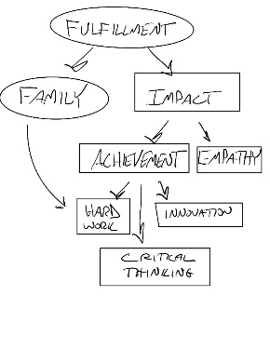
David Geller

Slide 23
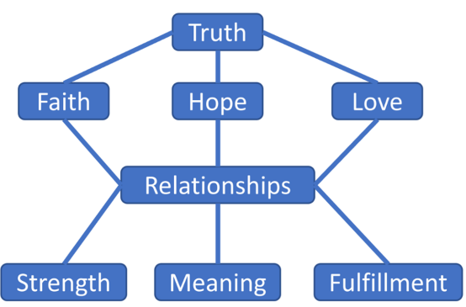
Brendan Gifford

Slide 25
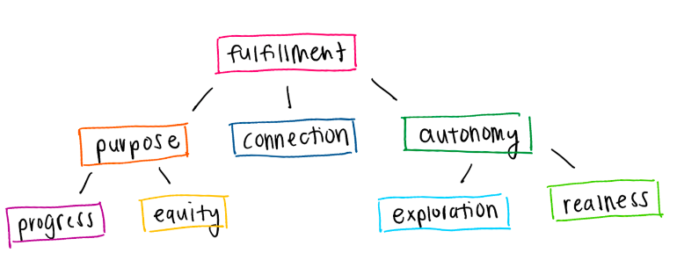
Allison Greenwald

Slide 27
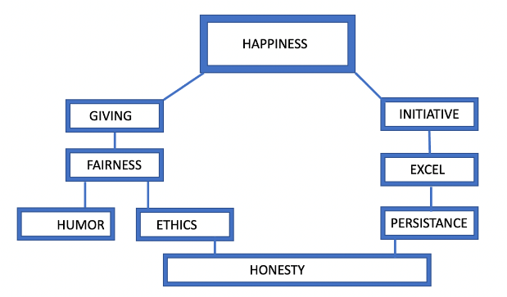
Raavi Gupta

Slide 29
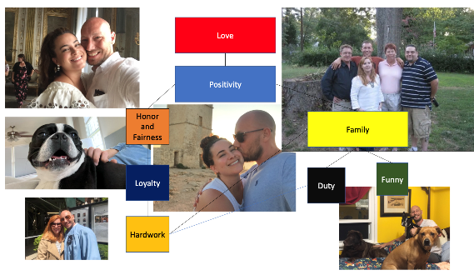
Samuel Hughes

Slide 31
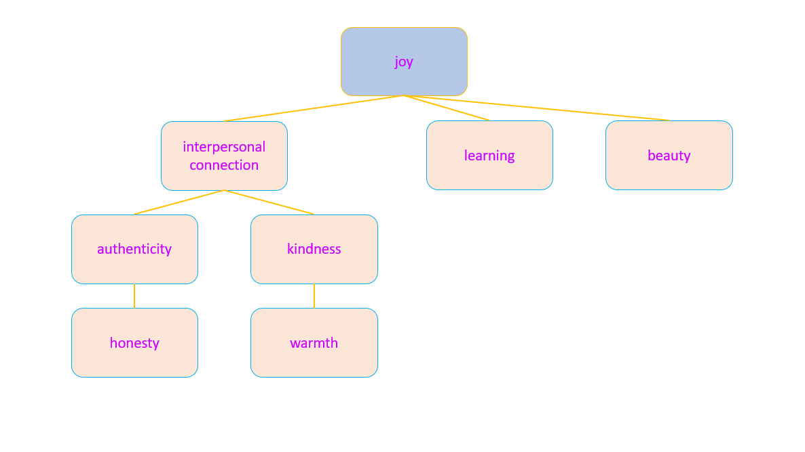
Keelia Jacobs

Slide 33
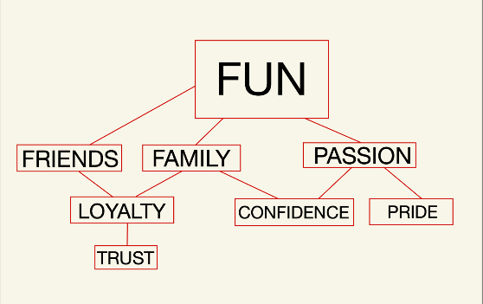
Justin Johnson

Slide 35
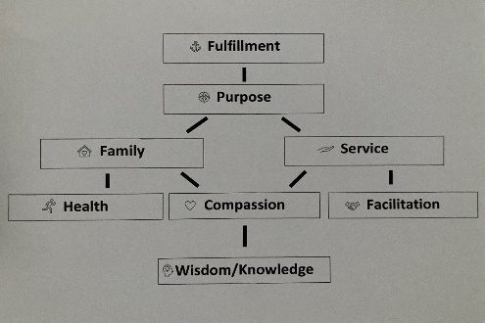
Joe Kemp

Slide 37
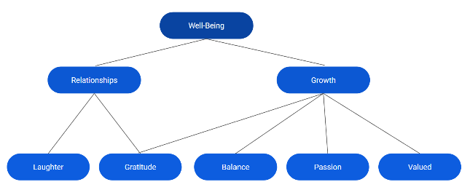
Chelsea Landon

Slide 39
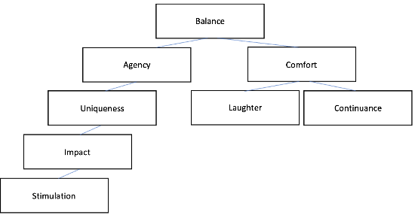
Brian Lapkin

Slide 41
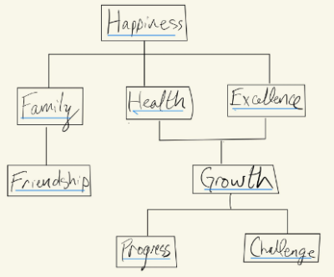
Thomas Luckey

Slide 43
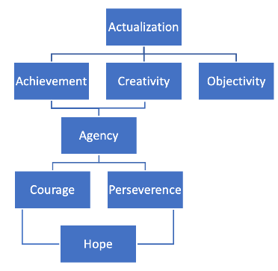
Igor Lukashevich

Slide 45
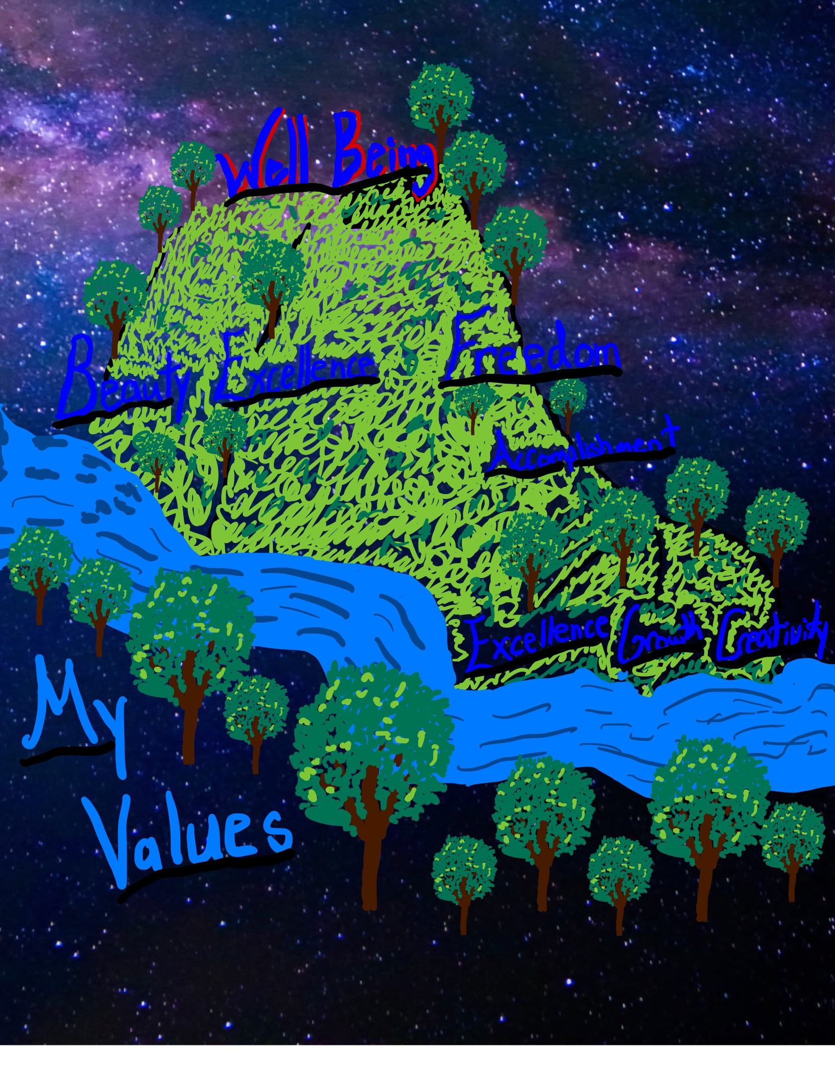
Aedan Macdonald

Slide 47
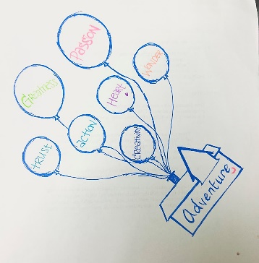
Jean Moon

Slide 49
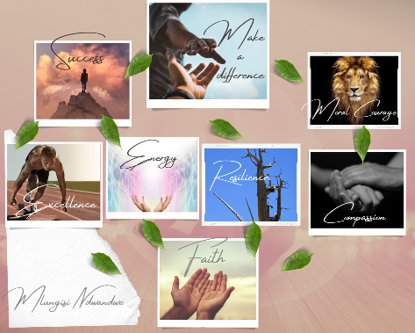
Mlungisi Ndwandwe

Slide 51
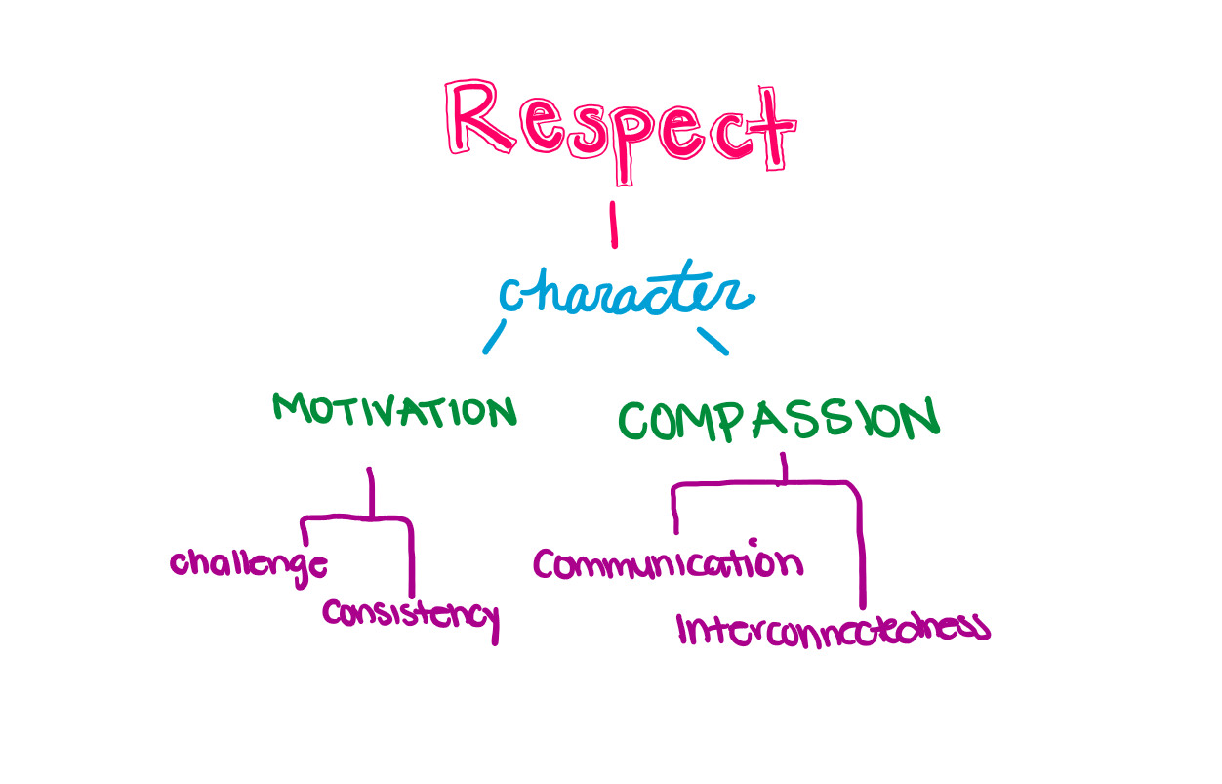
Kasey Ng

Slide 53
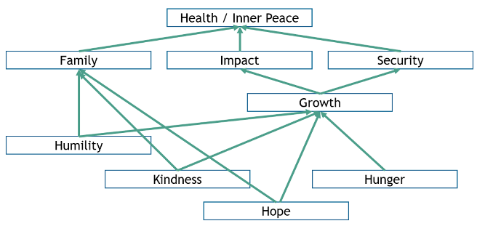
Justin Partyka

Slide 55
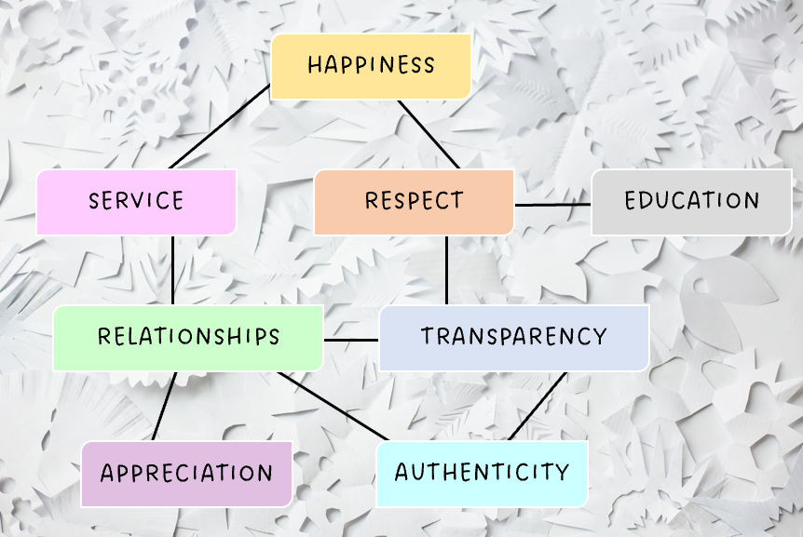
Emily Pramer

Slide 57
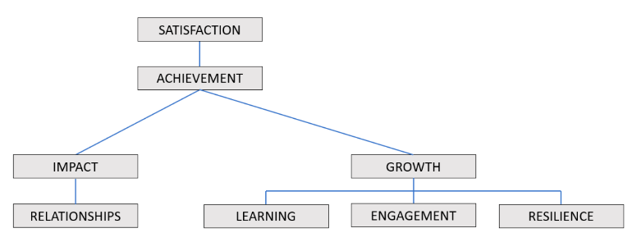
John Reid

Slide 59
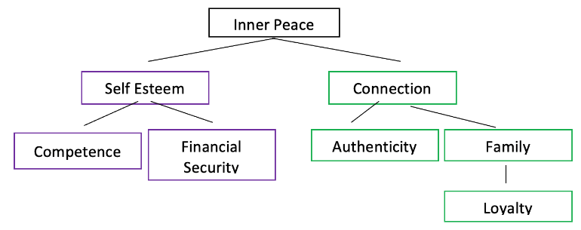
Simran Sahni

Slide 61
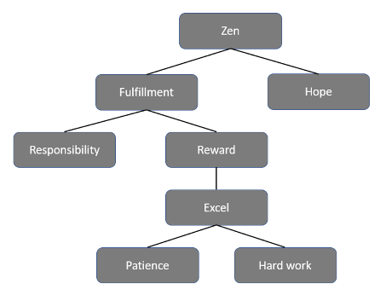
Anshul Sharma

Slide 63
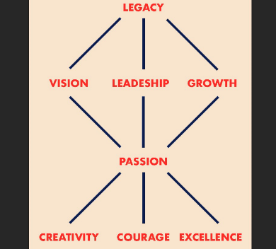
Marilisa Stigliano

Slide 65
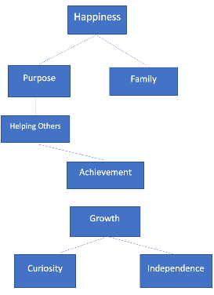
George Stoupakis

Slide 67
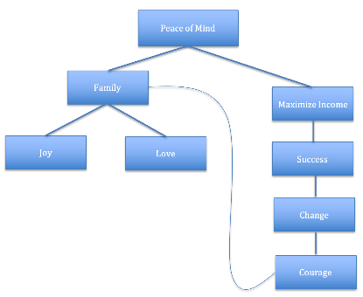
Raghav Sukhwal

Slide 69
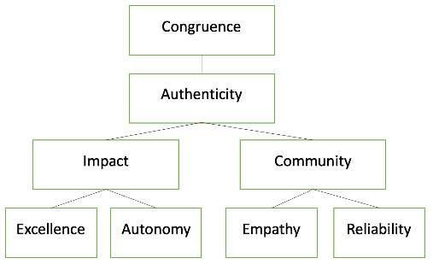
Kellie Valladares

Slide 71
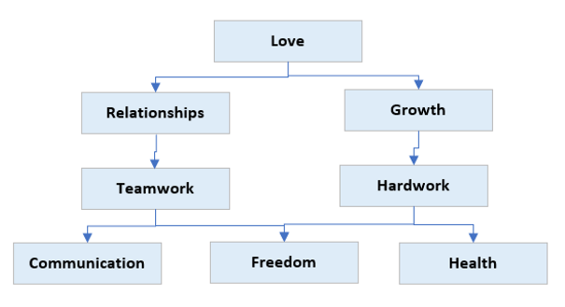
Thurman Van Riper

Slide 73
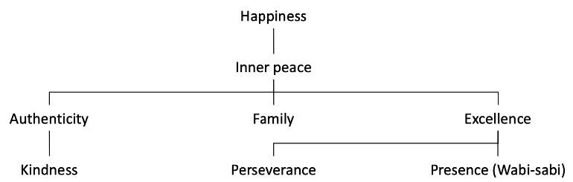
Gabriel Wong

Slide 75
Vera Adler
Awe (of the world)
Comfort
Admiration
Love
Justice
Significance
Honesty
Wealth
Security

Slide 77
Simpa Baiye
Faith
Family
Growth
Achievement
Reliability
Fairness
Integrity
Excellence

Slide 79
Atif Bhanjee
Zen
Actualization
Beauty
Awareness
Difference
Accomplishment
Exuberance
Active

Slide 81
Raji Bhimireddy
Connecting to the universe
Inclusion
Responsibility
Enthusiasm
Exuberance
Courage
Creativity
Loyalty

Slide 83
Thomas Bosley
Progress
Achievement
Growth
Action
Do the
right thing
Energy
Accountability
Agency

Slide 85
Alma Caballero
Growth
Joy
Dreaming
Family
Support &
Unity
Inner peace
& well being
Unioveness
Action
Presence

Slide 87
Alex Chan
Freedom
Tranquility
Satisfaction
Competence
Comfort
Adventure
Affirmation
Make things better

Slide 89
Siyi Chen
Love
Make a difference
Fulfillment
Moral courage
Commitment
Learning
Critical thinking

Slide 91
Sean Chrisom
Impact
Outcomes
Progress
Learning
Loyalty
Humility
Grit

Slide 93
Seungjin Han
Excitement
Achievement
Friendship
Diligent
Creativity
Trust
Freedom
Responsibility

Slide 95
Charli Kirk
Sense of well-being
Purpose
Impact
Balance family/work/life
Opportunity
Growth
Valued
Reward

Slide 97
Chengru Mao
Purpose
Strength
Authenticity
Excellence
Perseverance
Humor
Creativity
Curiosity

Slide 99
Morgan Murphy
Positivity
Health
Progress
Support
Grit
Truth
Kindness
Transparency

Slide 101
Mark O'Connell
Contentment
Achievement
Family
Honor
Excellence
Work-life
balance
Fairness
Wealth

Slide 103
Azmeen Peerbhai
Inner peace
Independence
Balance
Health
Service
Excellence
Family
Growth

Slide 105
Kevin Raftery
Equanimity
Family
Reward
Work life balance
Competence
Effort
Mentoring
Strength

Slide 107
Allison Renner
Fulfillment
Greatness
Recognition
Family
Growth
Caring
Ambition
Playfulness

Slide 109
Drew Sanders
Trust
Challenge
Accomplishment
Empowerment
Consistency
Honesty
Love

Slide 111
Madeline Silverman
Impact
Learning
Family
Fortitude
Curiosity
Adventure
Service
Energy

Slide 113
Akshdeep Singh
Optimism
Perservence
Collaboration
Ambition
Humor
Patience
Affection
Acknowledgement

Slide 115
Gabriel Tursi
Unconditional Love
Empathy
Generosity
Patience
Awareness
Communication
Tranquility
Excellence

Slide 117
Pranay Udutha
Optimism
Industriousness
Congeniality
Dreaming
Invention
Exuberance
Spontaneity
Courage

Slide 119
Christopher Vareika
Reliability
Focus
Learning
Change
Empathy
Pleasure
Spontaneous
Logic

Slide 121
Neil Wang
Hope
Openness
Determination
Connected
Confidence
Freedom
Fairness
Fun

Slide 123
Richard Witmer
Growth
Courage
Collaboration
Quality
Sense of humor
Trust
Learning

Slide 125
Dong Yang
Inner harmony
Learning
Relationship
Recognition
Do the right
thing
Openness
Trust
Goal oriented

Slide 127
Shizhong Zhao
Love
Diligence
Caring
Development
Excellence
Awareness
Family
Financial
Security

Slide 129
Jena Zoll
Serenity
Purpose
Wisdom
Motivation
Bravery
Equity
Wellbeing
Health

Slide 131
Alysa Kim
Happiness
Loyalty
Work life balance
Equality
Make a
difference
Validation
Adventure
Maximize income

Slide 133
Kevin Kilpatrick
Progress
Heart
Strong work ethic
Learning
Family
Loyalty
Resilience
Calm

Slide 135
Bhuvan Khanna
Legacy
Help People
Commitment
Pride
Character
Discipline
Peace
Humor

Slide 137
Michael Kerr
Fulfillment
Active
Family
Thinking
Adventure
Moral
Courage
Responsibility
Grit

Slide 139
Kathryn Kerns
Reward
Growth
Laughter
Confidence
Discipline
Comfort
Energy
Autonomy

Slide 141
Robert Jackson
Professionalism
Equanimity
Self esteem
Attention
Exuberance
Impact
Loyalty
Social Justice

Slide 143
Justine Dharni
Awe
Purpose
Fun
Free expression
Opportunity
Authenticity
Unity
Do the right thing

Slide 145
Jori Goodman
Fulfillment
Family
Groundedness
Dependable
Health
Optimism
Correctedness
Resourcefulness

